Slide 1

CRIME INCIDENTS 2012-2014
Data Science Project
Yvonne

Slide 2
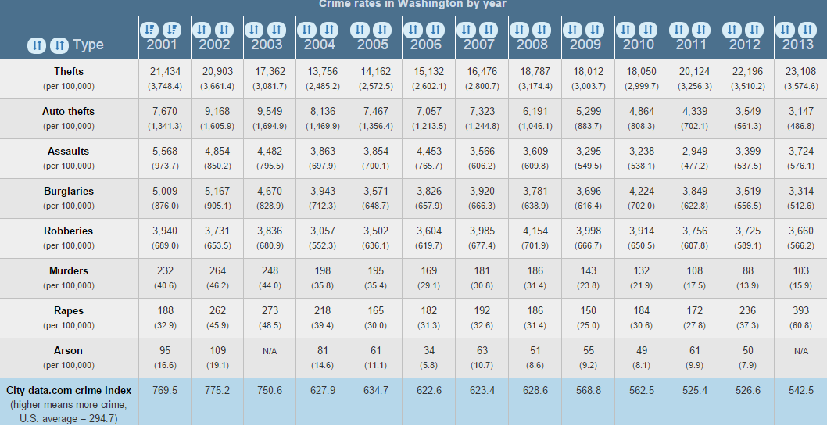
DC has been for many years above the average U.S. Crime Rate
Source: City-data.com

Slide 3
QUESTION:
IS IT POSSIBLE TO PREDICT THE TIMEFRAME FOR THE HIGHEST CRIME RATE FOR 2015 IN DC?

Slide 4
DATA HAS BEEN GATHERED FROM:
Crime Incidents 2012
Crime Incidents 2013
Crime Incidents 2014
These 3 datasets can be found through OCTO (download into a csv)
Employment Information 2012
Employment Information 2013
Employment information 2014
Dataset can be found at DOES.
Fahreheit by day 2012
Fahrenheit by day 2013
Fahrenheit by day 2013
Data has been collected from Dhttp://w2.weather.gov/.

Slide 5
DATA CLEANING AND EXPLORATION
Imported the Crime Incidents data
Since the date was in y/m/d/t I split the column to just the year for now. (I might split it later down to m/d/y)
I renamed the column that I know I want to work with.
I combined the Crime_Incident 2012, 2013 and 2014
Surprisingly Ward 4 had an increase over 700 crime incidents from 2012 to 2014, while Ward 8 crime incidents went down
It appears that the evening shift has a higher crime rate, you can also see that the crime rate increased from 2012 to 2014
I combined Employment Data, added the year to each file.
The Employment Data does give me the Ward information to join it with the crime incident data

Slide 6
CRIME INCIDENTS BY WARD PER YEAR
WARD | 2012 | 2013 | 2014
1 | 5058 | 5407 | 5408
2 | 6537 | 5950 | 6775
3 | 1781 | 1934 | 1824
4 | 3001 | 3262 | 3796
5 | 4795 | 4611 | 5379
6 | 5512 | 5669 | 6023
7 | 4344 | 4613 | 5108
8 | 4398 | 4433 | 4074

Slide 7
CRIME INCIDENTS IN A SHIFT PER YEAR
SHIFT | 2012 | 2013 | 2104
Evening | 14686 | 15154 | 16279
Day | 14436 | 14092 | 15248
Midnight | 6307 | 6636 | 6861

Slide 8
Crime Offenses in a Year
OFFENSE | 2012 | 2013 | 2014
THEFT/OTHER | 12480 | 12888 | 14628
THEFT F/AUTO | 9463 | 10131 | 11285
ROBBERY | 4268 | 4071 | 3333
BURGLARY | 3680 | 3369 | 3184
MOTOR VEHICLE THEFT | 2863 | 2675 | 3119
ASSAULT W/DANGEROUS WEAPON | 2295 | 2310 | 2398
SEX ABUSE | 257 | 299 | 309
HOMICIDE | 88 | 104 | 106
ARSON | 35 | 35 | 26

Slide 9
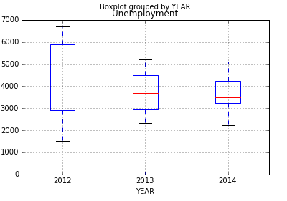
UNEMPLOYMENT RATE BY YEAR

Slide 10
Insight which has been gained after looking into the DATA
After importing the Employment information, I come to realize I will have to get the average of the Employment a year in order to work with the crime incident data on a yearly basis or I will have to break down the crime incident data to the monthly as well.
My previous question was: Can you predict the timeframe for the highest robbery crime rate in 2015. I will try to stay with that question, but I do want to get more information from the employment data. I am also considering adding race and ethnicity to get a better answer to the question
Found out that unemployment rate on the high-level does not play a roll in crime.

Slide 11
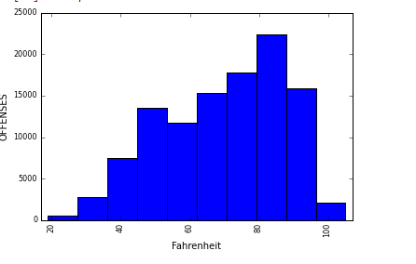
OFFENSE BY FAHRENHEIT
Looking a little further into how temperature actually compares to the quantity of the crimes – it shows that between 79
-91degrees is a higher Crime Rate

Slide 12
Further Data work
Since I collected the daily temperature data of each day for all 3 years, I tried to join it to the main crime data table
I had to split out the “ReportedDate” in the combined crime data to be able to join the weather tables with the crime table
I created new columns to have the [OFFENSE] as well as the [SHIFT] columns numeric to work on some predictions with it.
After losing my hair of trying to predict the Crime Rate for 2015 and not getting over 47% accuracy I have to say… I’ll keep on working on it to see what else I can pull out of the data other than my hair

